Slide 1
DSP LAB Experiment No. 5
Priya
17EE01044

Slide 2
Aim-
To compute pulse rate of given ppg signal using FFT(Fast Fourier Transform algorithm)
Extraction of respiratory signal information from ppg + respiratory signal using DFT

Slide 3
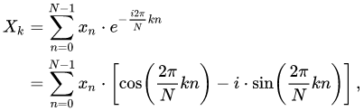
Theoy-
Fast Fourier Transform-
The FFT is a fast algorithm for computing the DFT.
To compute the DFT of an N-point sequence using equation (1) would take O(N2 ) multiplies and adds. The FFT algorithm computes the DFT using O(N log N) multiplies and adds.
Equation 1
There are 2 types of DFT-
1> DIT FFT(Decimation in time)
2> DIF FFT(Decimation in frequency)

Slide 4

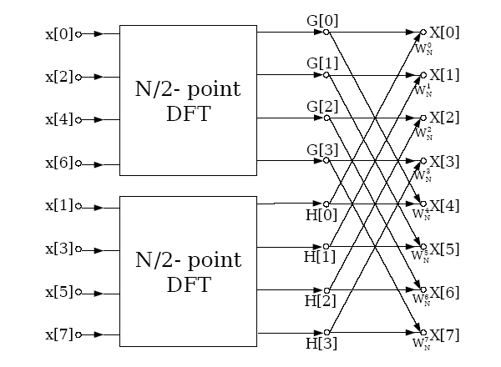
DIT FFT-

Slide 5
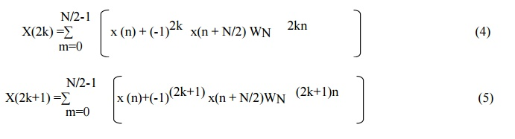
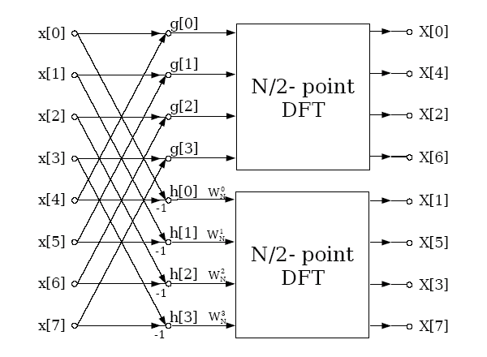
DIF FFT

Slide 6
Conclusion- FFT is fast method and with less order of computation complexity, Respiratory signal is observed between 0.05 and .5 Hz, so analysing that particular frequency we obtain respiratory signal

